Slide 1
Radiation and Its Measurement

Slide 2
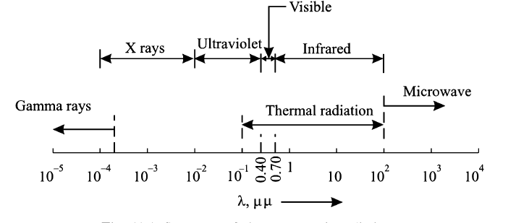
Spectrum of Electromagnetic Radiation

Slide 3
Introduction
Solar radiation incident on the outer atmosphere of the earth is called extraterrestrial radiation. The extraterrestrial radiation varies based on the change in sun–earth’s distance arising from earth’s elliptical orbit of rotation. The extraterrestrial radiation is not affected by changes in atmospheric condition.
When the radiation passes through earth’s atmosphere, it is subjected to a mechanism of atmospheric absorption and scattering depending on atmospheric conditions. Earth’s atmosphere contains various constituents, suspended dust and solid and liquid particles such as air molecules, oxygen, nitrogen, carbon dioxide, carbon monoxide, ozone, water vapor and dust. Therefore solar radiation or intensity of radiation is depleted during its passage through the atmosphere. Solar radiation that reaches earth’s surface after passing through earth’s atmosphere is called terrestrial radiation.
Irradiance
It is the rate at which radiant energy is incidenting on a unit surface area. It is the measure of power density of sunlight falling per unit area and time. It is measured in watt per square meter. Heat energy is measured in joules and while watt or joules per second is unit of power.
Irradiation
It is solar energy per unit surface area which is striking a body over a specified time. Hence it is integration of solar illumination or irradiance over a specified time (usually an hour or kilowatt a day). It is measured in kilowatt-hour or kilowatt day per square meter.

Slide 4
Contd…
Solar Constant
It is defined as the energy received from the sun per unit time on a unit surface area perpendicular to the direction of propagation of solar radiation at the top of earth’s atmosphere when earth is at its mean distance from the sun. The value of solar constant is taken as l367 W/m².
Beam radiation
Solar radiation along the line joining the receiving point and the sun is called beam radiation. This radiation has any unique direction.
Diffuse radiation
It is the solar radiation which is scattered by the particles in earth’s atmosphere and this radiation does not have any unique direction.
Total or global radiation
Total or global radiation at any location on earth²s surface is the sum of beam radiation and diffuse radiation.
Air Mass
The radiation reaching earth’s surface depends on (i) atmospheric conditions and depletion and (ii) solar altitude. Air mass is the ratio of the path length through the atmosphere which the solar beam actually traverses up to earth’s surface to the vertical path length through the atmosphere (minimum height of terrestrial atmosphere). At sea level, the air mass is unity when the sun is vertically is in the sky (inclination angle 90º)

Slide 5
Terrestrial & Extraterrestrial Radiation

Slide 6
Latitude & Longitude
On a globe of the earth, lines of latitude are circles of different sizes. The largest one is the circle at equator (circle at equator with center at earth’s center) whose latitude is taken as zero. The circles at the poles have latitude of 90º north and 90º south (or –90º) where these circles shrink to a point.
On the globe, vertical lines of constant longitude (meridians) extend from pole to pole similar to the segment boundaries on peeled orange. Every meridian has to cross the equator and equator is a circle.

Slide 7
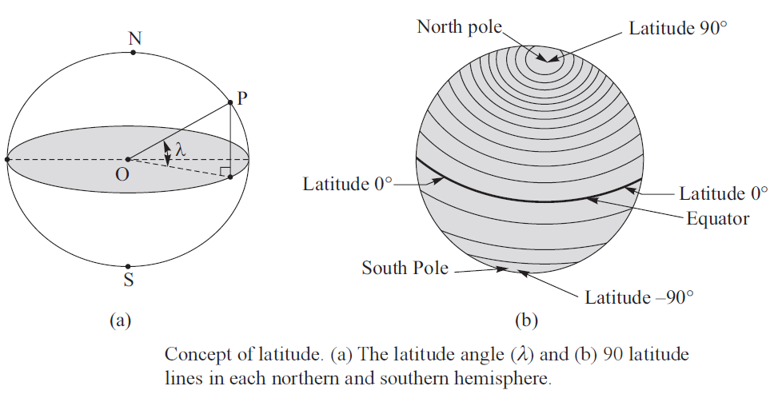
Latitude & Longitude

Slide 8
Longitude

Slide 9
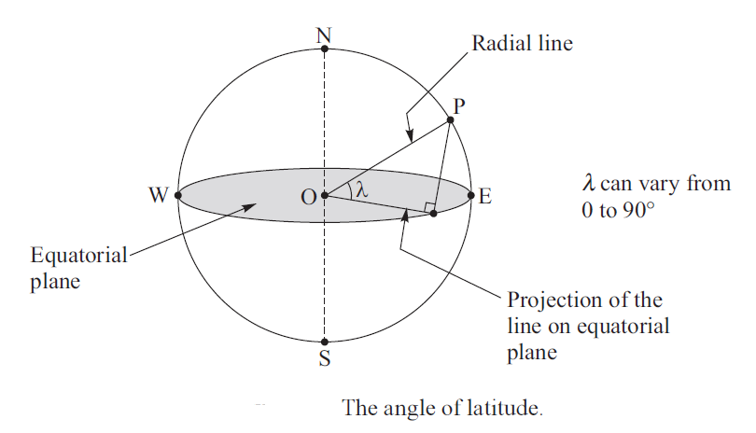
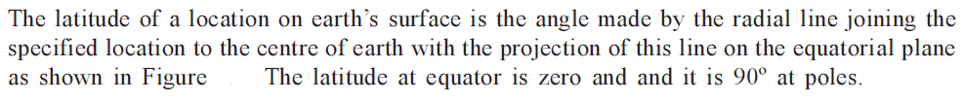
Basic Sun-earth Angles
Latitude or Angle of Latitude

Slide 10
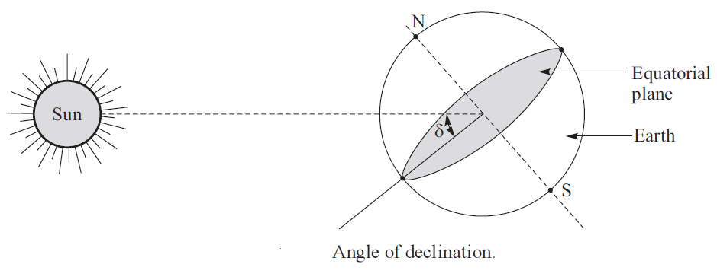
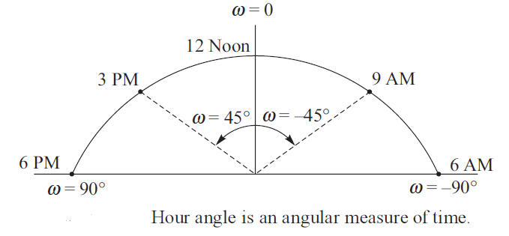
It is the angle made by the line joining the centers of sun and earth with the equatorial plane as shown in Figure.
The hour angle at any instant is the angle through which the earth has to turn to bring the meridian of the observer directly in line with suns rays. It is an angular measure of time. It is the angle in degree traced by the sun in l h with reference to l2 noon of the location.

Slide 11
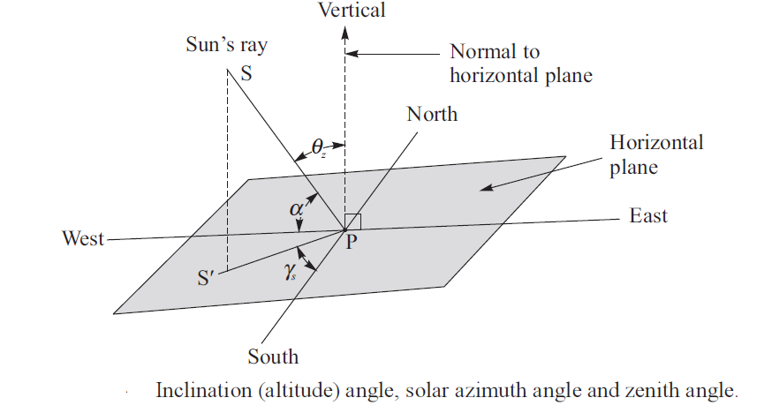

Slide 12
Inclination or Altitude angle (α)
It is the angle between sun’s ray and its projection on horizontal surface as shown in Figure
Zenith Angle (θ_{z})
It is the angle between sun’s ray and normal to the horizontal plane as shown in Figure.
Solar Azimuth Angle (γ_{s})
It is the angle between the projection of sun’s ray to the point on the horizontal plane and line due south passing through that point. The value of the azimuth angle is taken positive when it is measure form south towards west.

Slide 13
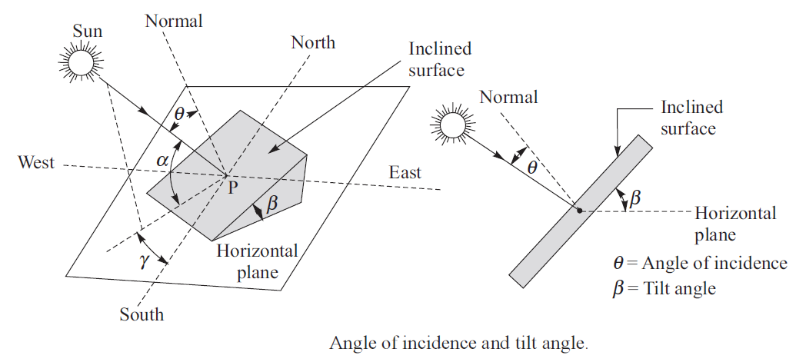

Slide 14
Angle of Incidence (θ)
The angle of incidence for any surface is defined as the angle formed between the direction of the sun ray and the line normal to the surface as shown in the Figure.
Tilt of Slope Angle (s)
The tilt angle is the angle between the inclined slope and the horizontal plane as shown in the Figure.
Surface Azimuth Angle (γ)
It is the angle in horizontal plane between the line due south and the horizontal projection of normal to the inclined plane surface. It is taken as positive when measured form south towards west.

Slide 15
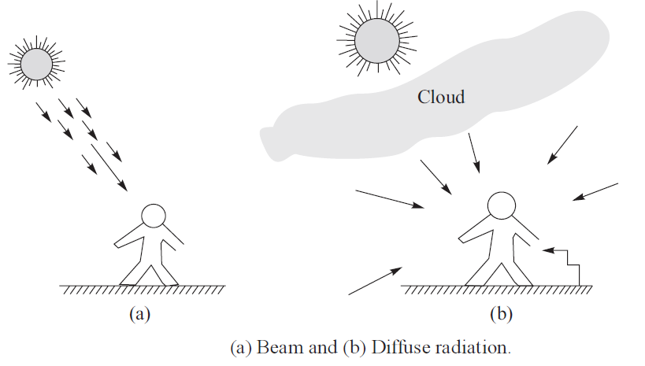
BEAM & DIFFUSE RADIATION

Slide 16
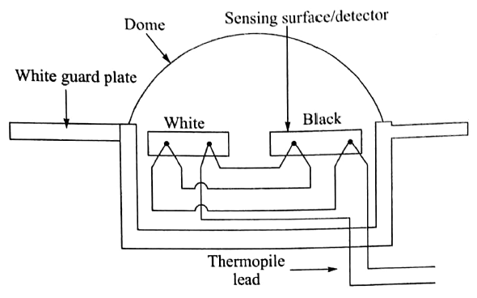
Pyranometer

Slide 17
Pyranometer
A pyranometer is radiation energy measuring device which is designed to measure global or total radiation.
When the instrument is shaded using a shading ring to prevent beam radiation reaching its detector, the pyranometer in this condition can measure only diffuse radiation.

Slide 18
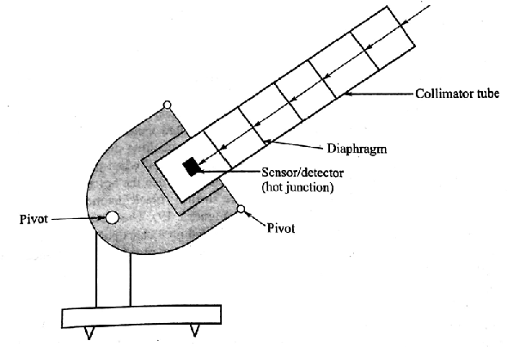
Pyrheliometer
To Measure Beam Radiation

Slide 19
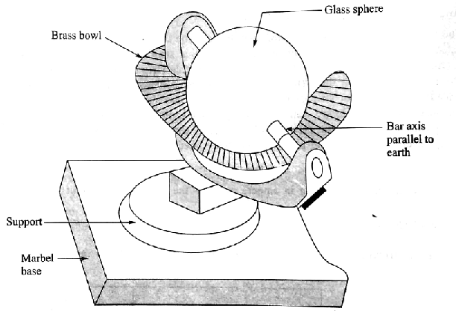
Sunshine Recorder
To Measure Bright Sunshine Hours

Slide 20
Sunshine Recorder
The instrument is used to measure the duration of bright sunshine hours in a day. It mainly consists of a glass sphere (diameter = l0 cm) mounted on its axis parallel to the axis of earth within a spherical section called bowl as shown in Figure. The bowl and glass sphere are arranged in such a way that sun’s rays are focused sharply as a spot on recording paper card held in a groove in the bowl. The card is made of a special coated paper with the printed time scale. The paper card has the property to burn a spot wherever sun’s rays fall on it. As the sun moves, the focused bright sun’s rays burn a path along the card paper. The length of the trace formed by the burn spots on the card paper is the measure of the duration of sunshine hours in a day. To take care of different seasons of the year, three overlapping pair of grooves to fix the card paper are provided in the bowl of the instrument.

Slide 21
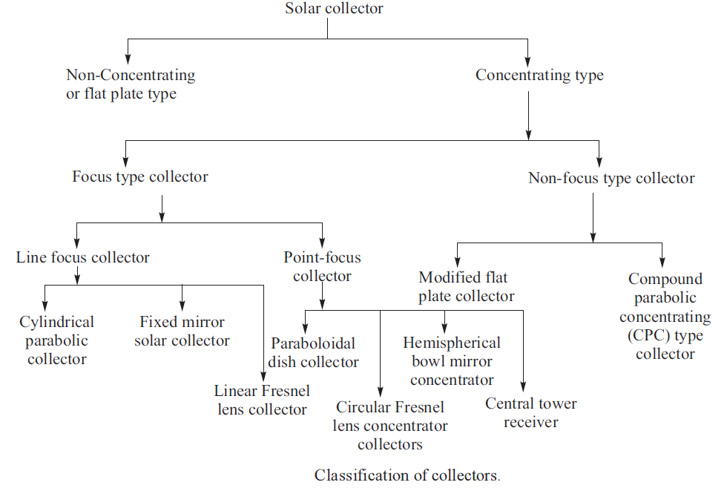
Solar Collectors: Classification

Slide 22

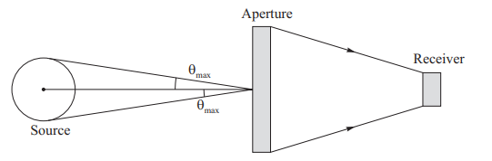

Important Features of Solar Collector
For Flat Plate Collector: <100ºC
Line focus Collectors: 150º-300ºC
Point focus Collectors: 500º-1000ºC
Collector Efficiency
Concentration Ratio
Temperature Range
CR is the ratio of area of aperture of the collector to the area of the receiver

Slide 23
Flat Plate Collector
Principle of Conversion
If incident radiation is unity on a body, then radiation can be absorbed, reflected, transmitted. If absorption coefficient, reflection coefficient and transmission coefficient are α, ρ and τ, respectively, then
α+ρ+τ=1
α … Absorption coefficient
ρ … Reflection coefficient
τ … Transmission coefficient
Components of Flat Plate Collector:
i) Absorber Plate
ii) Transparent Cover
iii) Fluid Tubes or Channels
iv) Thermal Insulation
v) Tight Container or Box

Slide 24
Absorber Plate: It is meant to intercept and absorb incident solar radiation. It is primarily a blackened heat absorbing plate usually made of copper, aluminum or steel. It may also be given a coating to minimize the emission of heat from its surface.
Transparent Cover: It is made of one or more transparent sheets of glass or plastic. It is placed above the absorber plate. The cover allows radiation to reach the absorber plate but it prevents any re-radiation and heat loss due to convection.
Fluid Tubes or Channels: Fluid tubes or channels are arranged in thermal contact with the absorber plate so that heat can be transferred from the absorber plate to the fluid in the tubes or channels.
Thermal Insulation: The thermal insulation is provided under the absorber plate and fluid tubes to minimize any heat loss by transmission or convection from the absorber plate and fluid tubes.
Tight container or box. All the above components of the collector are protected by a tight container or box as shown in Figure

Slide 25
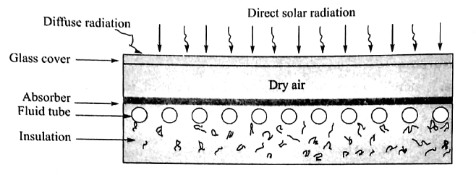
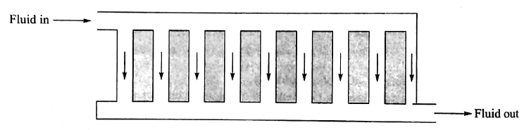
Layout of flat plate collector
Fluid Tube connection and Fluid Flow

Slide 26
The characteristic features of a flat plate collector are as follows:
It absorbs both direct and diffuse solar radiation.
It does not need any sun tracking system. Hence, it is mechanically stronger than other collectors which require tracking system.
It has simple construction requiring a little maintenance.

Slide 27
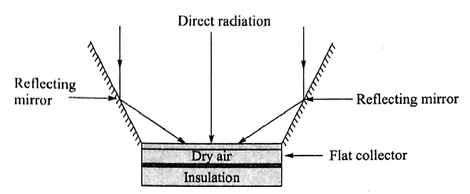
Modified Flat Plate Collector
CR: 1 to 4

Slide 28
Modified Flat Plate Collector
It is a modified form of the flat plate collector as it has plain reflectors at its edges to reflect additional radiation to the absorber or receiver and so there is some concentration of solar radiation at the receiver. The mirror reflectors are called booster mirrors which increase the acceptance angle and concentration ratio of the flat plate reflector from l to 4. The arrangement of the reflecting mirrors is shown in Figure

Slide 29
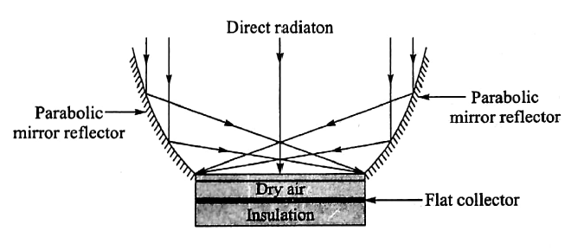
Compound Parabolic Concentrator
CR: 3 to 7

Slide 30
Compound Parabolic Concentrator
The compound parabolic concentrator (CPC) is mainly a flat collector having two parabolic mirror reflectors attached at the edge of the flat plate collector as shown in Figure. The parabolic mirrors are so adjusted that the focus of one mirror is located at the bottom end of the other mirror in contact with the receiver. The arrangement helps in increasing the acceptance angle. The concentration ratio achieved by this type of collectors ranges from 3 to 7.

Slide 31
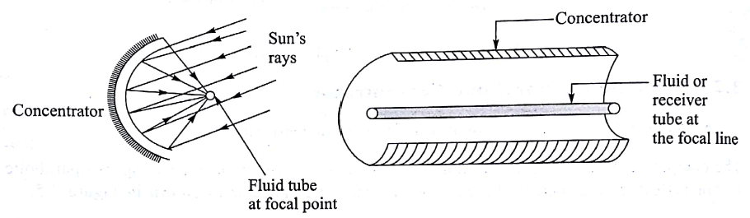
Cylindrical Parabolic Concentrator (Line Focal Concentrator or One axis Tracking collector)
CR: 5 to 30

Slide 32
Cylindrical Parabolic Concentrator
Cylindrical parabolic concentrator or parabolic trough collector consists of a cylindrical parabolic trough reflector with a metallic fluid tube or receiver tube containing fluid at its focal line as shown in Figure. In order to have better absorption of solar radiation, the fluid tube is blackened at outer surface. The concentrated solar radiation reaching the fluid tube heats up the transport fluid flowing through it. The collector with such concentrator has to be oriented to any of the following three directions: (i) East–West, (ii) North–South and (iii) Polar. Hence, such collector needs one-axis tracking system which can move the collector as per the sun²s movements in sky. These types of collectors have the concentration ratio in the range of 5–30.

Slide 33
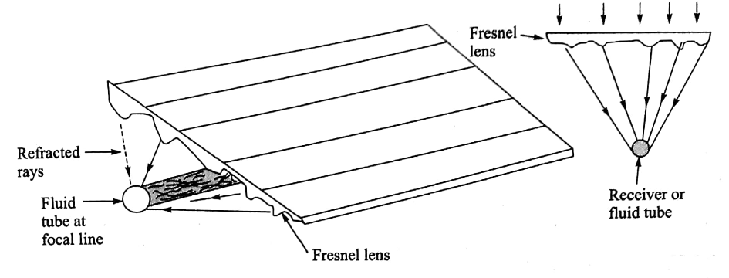
Fresnel Lens Collector
CR: 10 to 30

Slide 34
Fresnel Lens Collector
In this type of collectors, a concentrator in the form of Fresnel lens is used. The Fresnel lens consists of fine and linear grooves formed on one of the surfaces of some refracting materials sheet while its other surface is flat. The grooves provided on the sheet are designed in such a manner that these behave similar to spherical lens to every incident light rays. The incident radiation, therefore, converges on the focal line of the lens system where fluid tube is provided as shown in Figure. The heat is transferred to the transport fluid flowing in the fluid tube. A concentration ratio ranging from 10 to 30 is achieved. The temperature range of such collectors varies from l50 to 300°C.

Slide 35
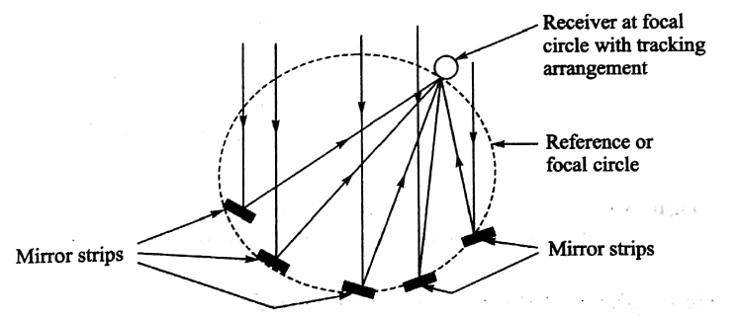
Fixed Mirror Solar Concentrator

Slide 36
Fixed Mirror Solar Concentrator
The concentrator consists of a number of long narrow mirror strips fixed on the circumference of a certain reference cylinder with a tracking receiver or fluid tube moving at the same circular circumference or focal circle as shown in Figure. The mirrors are arranged in such a manner that the incident radiation on them is focused on the receiver tube on their common focal circle. The receiver tube is made to move along the focal circle by a tracking device as per the movement of the sun in the sky. The concentration ratio of the concentrator is equal to the number of mirrors used for the concentration of radiation.

Slide 37
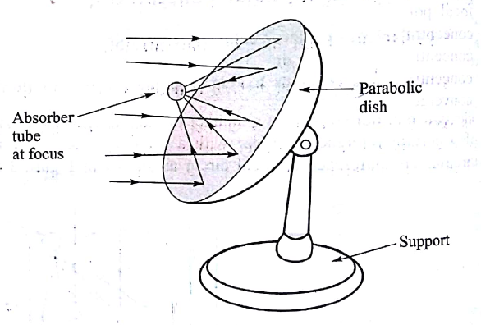
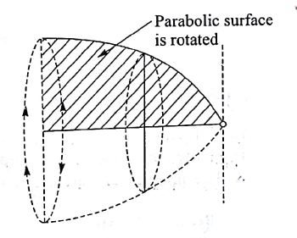
Paraboloidal Dish Collector
CR: 10 to 1000
Temperature up to 3000ºC
Generation of Paraboloid
Surface

Slide 38
Paraboloidal Dish Collector
A point-focus collector has a dish of the shape of a paraboloidal, that is, the surface produced when a parabola is rotated about its axis. The paraboloidal surface can concentrate all incident radiation parallel to its axis to a point focus where the receiver tube is positioned. In order to ensure proper incidence of radiation, the parabolic dish collector should be provided with two axes tracking: (i) by rotating the support structure about the vertical axis for dish alignment and (ii) the dish is rotated about a horizontal axis for elevation tracking as shown in Figure. This type of collectors can have concentration ratio ranging from l0 to l000 which helps to produce temperature up to 3000°C.

Slide 39
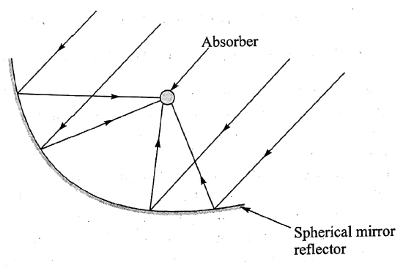
Hemispherical Bowl Mirror Concentrator
CR: about 2000

Slide 40
Hemispherical Bowl Mirror Concentrator
The hemispherical bowl mirror concentrator is a point focus concentrator in which reflector remains stationary and the receiver is made to track about two axes as per the movement of the sun in the sky so that solar radiation can be converged at the receiver kept at the focal point. The hemispherical fixed mirror, absorber with two axes tracking system and supporting structure of the collector are as shown in Figure. All the sun rays entering the hemisphere after reflection are concentrated at focal point. The absorber should be moved in such a way that it is always at the converging point of the sun rays after the reflection.

Slide 41
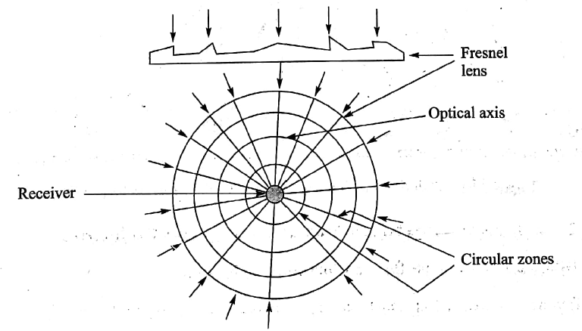
Circular Fresnel Lens Concentrator
CR: about 3000

Slide 42
Circular Fresnel Lens Concentrator
The principle of working of this type of collector is similar to the linear Fresnel collector and the only difference is that this type of collector is designed to concentrate the radiation at one focal point instead of line focus. These Fresnel lenses concentrators are used where high concentration of radiation is required, for examples, with silicon solar cell receiver. The concentrator has a number of thin circular zones with fine grooves so designed that the lens concentrator behaves optically as a thin spherical lens. The sun rays are made to refract and converge at a point as shown in Figure. The concentration ratio obtained by this concentrator is very high with a value of about 2000.

Slide 43
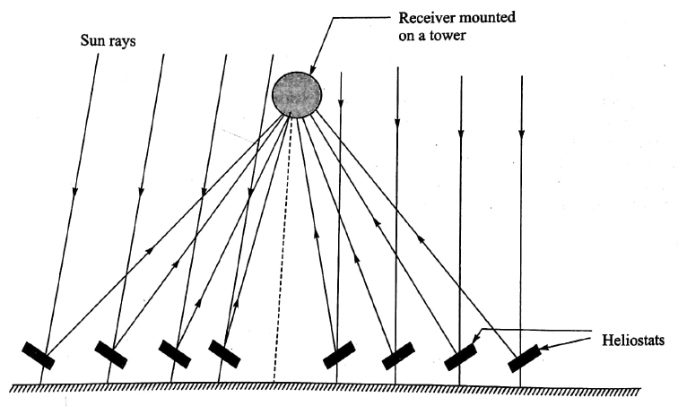
Central Tower Receiver Collector

Slide 44
Central Tower Receiver Collector
In this type of collectors, the receiver is located at the top of a tower and solar radiation is reflected on it from a large number of independently controlled flat mirrors called heliostats. The heliostats can be moved independently about two axes so that the reflected solar radiation is always directed towards the absorber mounted on the tower as shown in Figure. The heliostats are spread over a large area on ground surrounding the absorber mounted on the tower. The number of heliostats can be as high as thousands and they simultaneously track the sun to reflect the solar radiation from all sides on the receiver. These heliostats together act as a very large paraboloidal dish collector. The concentration ratio as high as 3000 can be obtained by this point type concentrator called central tower receiver collector. The solar radiation at the receiver is converted into heat, which is transported to a heat engine or any other device for use.

Slide 45
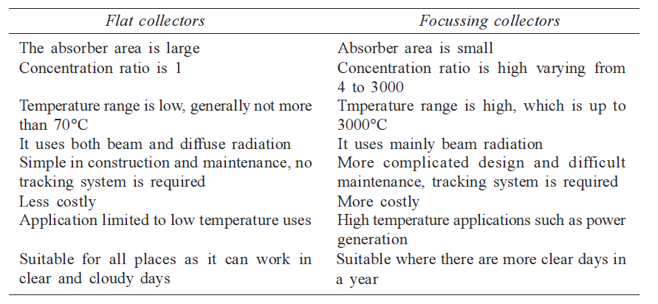
Comparison Between Flat and Focussing Collectors

Slide 46
Solar Energy Storage: Classification

Slide 48
Electromagnetic Energy Storage
Superconductivity is a phenomenon of exactly zero electrical resistance and expulsion of magnetic fields occurring in certain materials when cooled below characteristic critical temperature.
SMES is an energy storage system that stores energy in the form of DC electricity by passing current through the super conductor and stores the energy in the form of DC magnetic field.
The conductor for carrying the current operates at cryogenic temperature where it becomes superconductor and thus has virtually no resistive losses as it produces magnetic field.
The magnetic field is created by flow of direct current through the coil.
In this state the current in a coil can flow for infinite time.
SMES systems are highly efficient, the efficiency is greater than 98%.
Useful superconducting materials available commercially are niobium titanium alloy at temperatures below -263°C and a compound of niobium and tin below -255°C

Slide 49
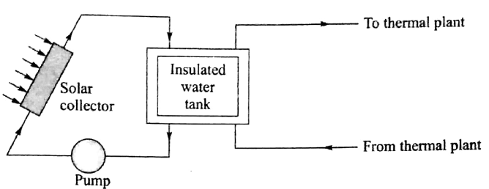
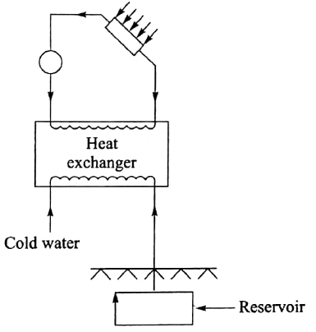
Sensible Heat Storage
Short-term Sensible Heat Storage by Water
Long-term Sensible Heat Storage by Water

Slide 50
Sensible Heat Storage
Thermal energy is stored in this types of storage by virtue of heat capacity and temperature difference developed during charging and discharging. The temperature of the storage material rises when thermal energy is absorbed and temperature drops when thermal energy is taken out. In this storage, the charging and discharging can be performed reversibly for an unlimited number of times. The sensible heat storage can be liquid media storage and solid media storage. Water is considered as the most suitable media for storage below l00°C. Liquids such as oils, liquid metals and molten salts are also used as liquid media storage.
The water thermal energy storage can be short term and long term. A short-term thermal energy storage system has a well-insulated storage tank as shown in Figure S.l4. The storage in such tank is economical for few days only as heat losses over long duration make the storage uneconomical. Long-term sensible heat storage by water is possible in underground reservoirs having special insulation. In this system, water is heated in charging mode by passing it through a heat exchanger and then it is stored in an underground reservoir. In the discharge mode, the hot water is made to flow back through the heat exchanger, where it releases the stored energy as shown in Figure S.l5 but with reverse circulation.

Slide 51
Sensible Heat Storage
Advantages.
Water has the following advantages:
It is abundantly available.
It is inexpensive.
It has high specific heat which enables to store more heat per unit mass.
It has low viscosity requiring less energy to pump through the pipe system.
It can be used for both storage and working medium.
It is stable.
It has no harmful effect.
Disadvantages.
Water has the following disadvantages:
It has limited temperature range of 0–l00°C.
It results in the corrosion of pipes.
It can leak easily as it has low surface tension.

Slide 52
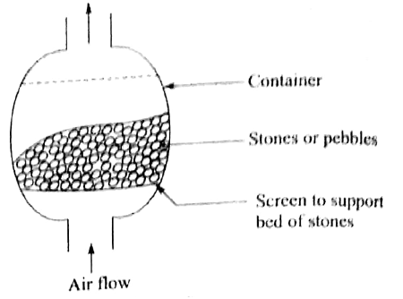
Solid Media Storage or Packed Media Storage

Slide 53
Solid Media Storage
This type of storage has a bed of loosely packed solid materials such as rocks, sand, concrete, pebbles and metals to store sensible heat. A fluid such as air is circulated through the bed to add or remove heat from the storage. This type of solid media storage has no limitations such as (i) low temperature due to freezing and (ii) high temperature due to vapourizing as applicable in the case of liquid media storage. A typical packed bed storage unit is shown in Figure. It consists of a container, a screen to support the bed, inlet duct and outlet duct. The charging or adding of heat is done by passing hot air through the bed in one direction and the removable of heat is done by passing the normal air through the bed in the opposite direction.

Slide 54
Advantages. The advantages of solid media storage are as follows:
Stones or pebbles are abundantly available
Low cost
Non-combustible
Easy to handle
Possibility of high storage temperature
No freezing point during heat removal
No corrosion problem
No requirement of heat exchanger
Disadvantages. The disadvantages are as follows:
The size of the storage container should be large
Simultaneously charging and discharging of energy is impossible
Large pressure drop needs high capacity air blower

Slide 55
Latent Heat Storage
Glauber’s salt (sodium sulphate decahydrate)

Slide 56
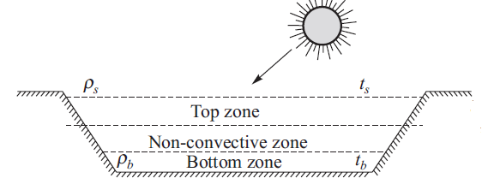
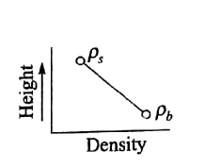
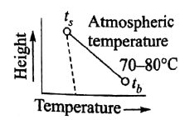
Solar Pond
Concept of Solar Pond

Slide 57
Solar Pond
Principle. In ordinary pond, when water is heated up by the sun rays, the heated water rises to the top of the pond. The hot water loses heat to the atmosphere, and so the net temperature at the top of the pond remains nearly at atmospheric temperature. The solar pond technology ensures that heated brine water remains at the bottom of the pond due to more brine concentration and density in it.
The solar pond serves the dual purpose of a large flat collector and a thermal storage system. It consists of a large size brine pond (depth of about l m) which has salt concentration gradient in such a way that the most concentrated and dense part of the brine solution is at the bottom of the pond and brine concentration gradually reduces from bottom to top of the pond based on the variation of brine solution density. A solar pond has three zones as shown in Figure. The top zone is surface zone which has the least salt content and its temperature is the atmospheric temperature. The bottom zone has the maximum salt content and it has a high temperature (70–85°C). This is the zone that collects and stores the solar energy as heat energy. In between these two zones there is the gradient non-convective zone.

Slide 58
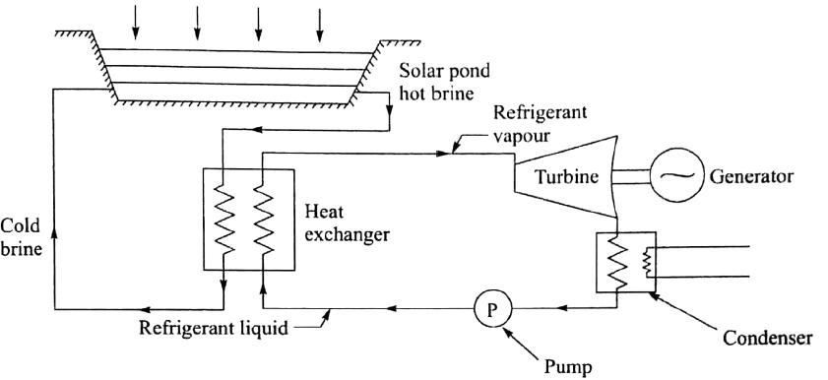
Layout of Solar pond Electric Power Plant

Slide 59
Contd…
The hot brine solution from the bottom of solar pond is taken out without disturbing the brine gradient existing in the solar pond. This solution is taken to heat exchanger to remove heat from the brine solution by evaporating a refrigerant in the evaporator. These vapours are used to run a turbine which is coupled to a generator to generate power. The refrigerant vapours exiting from the outlet of the turbine are condensed to liquid state in a condenser and pumped to heat exchanger. Solar pond electric power plant is shown in Figure.

Slide 60
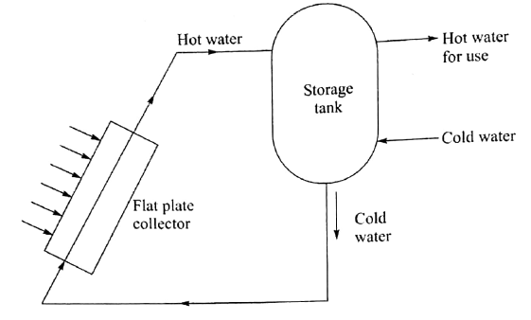
Solar Water Heater

Slide 61
Solar Water Heater
A small capacity water heating system with natural circulation is as shown in Figure. It is suitable to supply hot water for domestic purposes. It has two main components which include (i) flat plate collector to convert solar radiation into heat energy and (ii) water storage tank to store hot water. The tank is located above the level of collector. Heat is transferred to the water in the solar collector and hot water rises to flow in the water tank. The hot water enters the top of the water tank and cold water from the water tank moves out from the bottom of the tank so as to enter the inlet of the collector. The natural circulation of water is established from the collector to water tank and then from water tank to the collector. The hot water for use is withdrawn from the top of tank, which is replaced by cold water entering at the bottom of the tank. Water heating system is also provided with an auxiliary heating system so that the system can also work during cloudy and rainy days when sufficient solar radiation is unavailable.

Slide 62
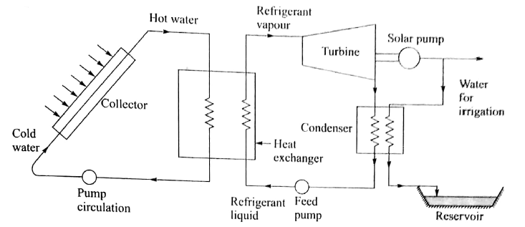
Solar Thermal Pump

Slide 63
Solar Thermal Pump
Solar pumping utilizes the mechanical power generated by the solar radiation to run the water pump. Solar energy offers several beneficial features which make its utilisation in irrigation pumping quite attractive. The features are as follows:
The need for pumping arises most during the summer months when solar radiation is intense.
Pumping can be carried out intermittently without any problem.
Surplus pumped water can be stored in a reservoir or tank.
The requirement of water decreases during periods of low radiations when solar pumping decreases. Evaporation losses reduce during cloudy days. Rainwater is also available during rainy days.
There is relatively inexpensive running and maintenance cost.
The solar pump is similar to solar heat engine working in low-temperature range. The source of heat is a solar collector. The heat is transported to a heat exchanger where heat is transferred to a refrigerant of low boiling point. The refrigerant evaporates and high-pressure vapour is taken to a turbine to do useful mechanical work by running the solar pump as shown in the Figure. The outlet refrigerant vapour from turbine is condensed and taken to heat exchanger using feed pump for reuse

Slide 64
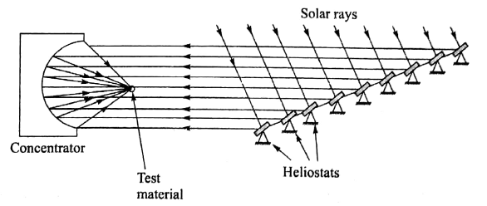
Solar Furnace

Slide 65
Solar Furnace
Principle. Solar furnace is used to study the properties of the materials, such as physical, mechanical, chemical and electrical properties at high temperatures. The focusing type solar collectors can concentrate solar radiation over a small area in a furnace for heating of materials being tested. It is possible to obtain high temperatures which can be about 3500°C.
The solar furnace has basically two main components: (i) a concentrator with arrangement to position testing materials at its focus and (ii) a system of a large number of small heliostats. The large number of heliostats are located and positioned in such a manner that they direct solar radiation onto a paraboloid collector. The solar radiation after reflection from the heliostats moves parallel to the optical axis of the concentrator. The heliostats are provided with systems of sun tracking. The container focusses the incoming solar rays on to the test material to heat up.

Slide 66
Advantages and Disadvantages
The advantages of a solar furnance are as follows:
It gives pure heating without contamination.
It provides easy control of temperature.
No adverse effect is produced on the test material by the sun rays.
It has simple working principle.
It provides an easy observation of test material while heating.
It gives high rate of heating by intense radiation concentrated at a point.
The disadvantages are as follows:
It can be used during sunshine hours.
The cost of equipment is high.
Materials with small area can be only heated and tested.

Slide 67
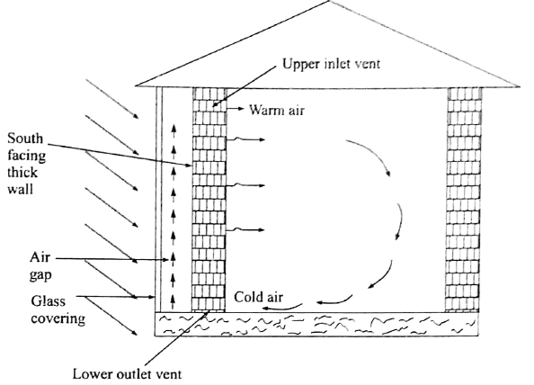
Solar Passive Space Heating
Passive System: In which solar radiation is collected by some element of the
structure itself or admitted directly into building through large south facing windows.

Slide 68
Solar Passive Space Heating
Solar energy can be used for passive heating of buildings to maintain comfortable temperature inside the buildings. Passive heating of buildings does not require any mechanical device. This heating consists of natural processes such as convection, radiation and conduction which are used to transport heat in the space. The heating necessitates a suitable building design to ensure natural flow of heat in the space inside building. Such specially designed building is called solar house.
In the northern hemisphere, the sun rays come from south direction. Hence in order to achieve solar passive heating in cold regions, south facing wall is made thick using concrete or stones to store the maximum heat energy from the incident solar radiation. The entire south wall is further provided with a plastic or glass sheet covering with an air gap in between the wall and the sheet covering. The incident solar radiation after passing through the sheet covering is absorbed by the thermal storage wall. The warm air in air gap rises and enters into the space inside the building to be heated as shown in Figure. The warm air enters into the space from the upper inlet vents and cold air is removed from the space from the lower outlet vents.

Slide 69
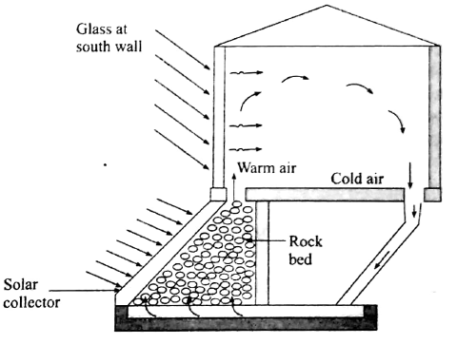

Contd…

Slide 70
Contd…
There is another method to provide solar passive space heating, which is shown in Figure. In this method, a flat plate collector is provided to face south. The collector is provided with rock bed type storage system. During sunshine hours, the collector transfers and stores heat energy from incident solar radiation into the rock bed storage system. The available stored energy in the rock bed is used later at night when air is passed through the rock bed, and so warm air enters into the space to be heated.

Slide 71
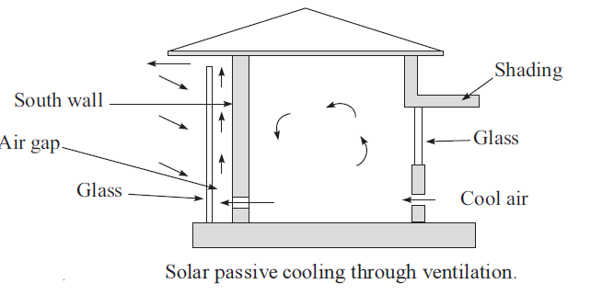
Solar Passive Space Cooling

Slide 72
Solar Passive Space Cooling
The heat tends to enter a building in the following ways:
Direct sunlight heat which can be reduced by using shading and providing venetian blinds to glass windows and doors.
Conduction of heat through walls, roof and floor. It can be reduced by providing insulation. Maximum heat is conducted through the exposed roof which has to be provided a false ceiling with a good insulating materials to reduce the conduction of heat from it.
Infiltration of outside hot air. It can be reduced by proper sealing of the space and reducing the openings of doors and windows.

Slide 73
Solar Passive Space Cooling
The methods to reduce or prevent heating of the space are as follows:
Shading of glass area and the walls
Providing air circulation or ventilation so that warm air is driven out and cool air from outside is sucked into the space using chimney effect as shown in a Figure.
Providing a pond on the roof to reduce radiation heating and achieve cooling below the pond
Providing black plastic bags on a metallic roof which helps in radiating out the heat from the space during night-time
Providing ground coupling or basement construction to maintain temperature of the space close to ground temperature.

Slide 74
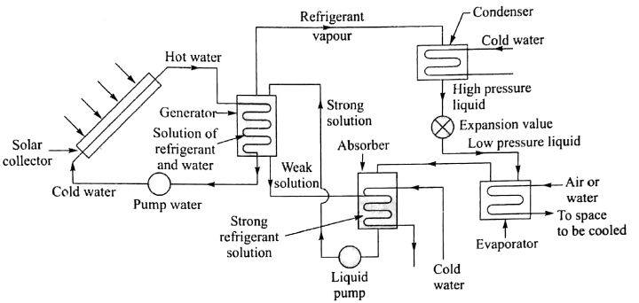
Solar Refrigeration and Cooling System

Slide 75
Solar Refrigeration and Cooling System
A simple solar operated absorption refrigeration system to cool a space is as shown in Figure. The hot water transported from a flat plate collector is passed through a generator which is a heat exchanger. The heat is transferred to a refrigerant and absorber solution. The refrigerant can be ammonia or water while absorber is water or lithium bromide which generates refrigerant vapors at high pressure. The high-pressure vapors are condensed into high-pressure liquid in the condenser. The high-pressure refrigerant liquid is throttled to low pressure and temperature by an expansion valve. The low pressure refrigerant takes heat from the evaporator and vaporizes, thereby cooling air or water which can be used for cooling the space inside the building. The refrigerant vapor is ultimately absorbed into the weak solution taken from generator to the absorber, thereby converting it into strong solution of the refrigerant. The strong solution is pumped from the absorber to the generator for the repeat of the refrigeration cycle.

Slide 76
Lithium bromide-water system
Water is refrigerant and lithium bromide is absorber. The absorber has pressure of 0.l atm and temperature of 90°C while evaporator has pressure of 0.008 atm and temperature of 4°C.
Merits
It is a comparatively simple system.
It has high coefficient of performance.
It requires less power for pumping water from absorber to generator due to lesser pressure in the generator.
Water as refrigerant has more latent heat of vaporization.
Lithium bromide is non-volatile which helps to prevent water vapor from going out of generator to condenser.
Demerits
As it can develop low temperature of 4°C only in evaporator. The system can be used for only air conditioning purpose.
The solution is corrosive.
Maintaining very low pressure in the evaporator and absorber is problematic.
Condenser has to be water cooled. Air cooling of condenser is not possible.

Slide 77
Aqua-ammonia absorption system
It has ammonia as refrigerant and water as absorber. The generator has pressure of l0 atm and temperature of l20°C, while evaporator has pressure of l atm and temperature of –5°C.
Merits
It is suitable for both air conditioning and refrigeration.
Condenser can be air or water cooled.
The absorber is water, which is non-toxic and inflammable.
Demerits
A rectifier is require to separate water entering into condenser.
High pumping power to pump refrigerant from the absorber to the generator is required.
Ammonia is inflammable.
Ammonia is toxic.

Slide 78
Solar VCR and Cooling

Slide 79
Solar VCR and Cooling
Vapour compression system can be used for both cooling and heating. If the vapour compression system takes heat from space and releases to atmosphere, it is working as cooling system. On the other hand, if the vapour compression system takes heat from atmosphere and releases the same into the space, it is working as heat pump. The vapour compression system working with solar radiation to cool a space is shown in Figure. Solar power is converted into mechanical work using turbine which then runs a compressor coupled with it. The compressed refrigerant is expanded into evaporator, providing the requisite cooling.

Slide 80
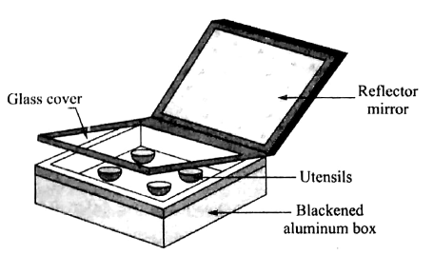
Solar Cooker

Slide 81
Solar Cooker
A solar cooker consists of (i) an insulated box of blackened aluminium in which utensils with food materials can be kept
(i) reflector mirror hinged to one side of the box so that the angle of reflector can be adjusted and
(ii) a glass cover consisting of two layers of clear window glass sheets which also serves as the box door as shown in Figure.
The box is kept in such a way that solar radiation falls directly on the glass cover and reflector mirror is also adjusted in such a way that additional solar radiation after mirror reflection is also incident on glass cover. The glass cover traps heat owing to the greenhouse effect, that is, short-wavelengths radiation can pass inside the box but long-wavelengths radiation coming out from the box is entrapped in the box, thereby providing more heating effect. The air temperature obtained inside the box ranges from l40 to l60°C. This provides sufficient heat for boiling and cooking purposes.

Slide 82
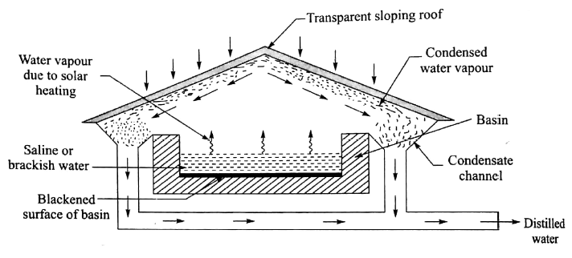
Solar Distillation

Slide 83
Solar Distillation
The process to convert saline water into pure water using solar radiation is called solar distillation. A solar device used for this purpose is called solar still. A solar still consists of a shallow blackened basin filled with saline or brackish water to be distilled. It is covered with sloping transparent roof as shown in Figure. The sun rays can pass through transparent roof and these rays are absorbed by the blackened surface of the basin, thereby increasing the temperature of water. The water in basin evaporates due to solar heat and rises to the roof. The water vapour cools down and condenses at the undersurface of the roof. The water drops or condensed water slip down along the sloping roof. The condensed water is collected by the condensate channel and drained out from the solar still.

Slide 84
Solar Thermal Power plant

Slide 85
Solar Thermal Power plant
The solar thermal power plants can use different systems, such as
Low temperature solar power plant using flat plate collectors
Low temperature solar power plant using solar pond
Medium temperature solar power plant using focusing collectors
High temperature solar power plant which can be
Distributed collector system called solar farms
Central receiver system or tower power plant

Slide 86
Solar Thermal Power plant
The principle of these plants is the same, which involves transportation of heat generated by the absorption of solar radiation. In medium and high temperature solar plants, steam is generated which is made to run a turbine with a generator coupled to it. In a low temperature solar system, transported heat is used to (i) generate vapour of low boiling point refrigerant using a heat exchanger and (ii) to run a turbine coupled with generator using refrigerant vapour. A central tower receiver solar power plant is shown in Figure.

Slide 87
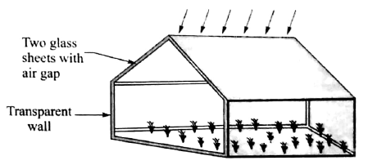
Solar Green House

Slide 88
Solar Green House
A greenhouse is a shed or enclosure in which a proper environment is provided to enable the growth and production of vegetables and flowering plants even during adverse and severe climatic conditions prevailing outside. Any vegetable or flowering plants can be grown through- out the year if suitable environmental conditions are provided.
In a greenhouse, visible light, carbon dioxide and water are provided as required for photosynthesis process. The photosynthesis process can be given as
Light energy + CO2 + water = Carbohydrate + O2
The carbohydrate produced in photosynthesis is used by plants during respiration process for growth. The respiration process can be given as
Carbohydrate + O2 = CO2 + energy + water

Slide 89
Solar Green House
A typical greenhouse is shown in Figure. To ensure enough sunlight inside the greenhouse, sufficient glass or transparent plastic sheet is provided in roof and walls in the greenhouse facing the sun. For roof, two layers of glass or plastic sheets are provided with small air gap in between to obtain proper thermal insulation. The air gap helps in entrapping the solar radiation inside the greenhouse as it prevents the passing out of long-wavelength radiation from inside of the greenhouse to the atmosphere. Adequate presence of carbon dioxide is ensured by (i) supplying outside air (ii) using organic manure (iii) combustion of sulphur-free fossil fuels and (iv) carbon dioxide gas.

Slide 90
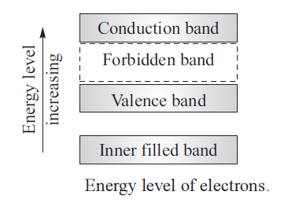
Solar Photovoltaic Systems
Solar cell Fundamentals
Valence Band
Conduction Band
Forbidden Band

Slide 91
Solar Photovoltaic Systems
The electrons in the outermost shell of an atom are called valence electrons. The band occupied by valence electrons is called valence band. The highest permitted band is called the conduction band, which is at higher energy level than the valence band. The electrons in this band move freely. The energy gap in between the conduction band and the valence band is called forbidden band as electrons cannot exist in this band.

Slide 92
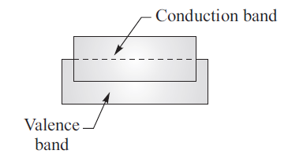
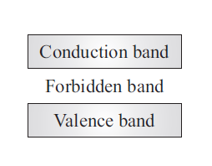
Conductor, Semiconductor and Insulators
Overlapping of bands
In conductors
Narrow gap in between
In semiconductors
Wide gap in between
Bands in insulator

Slide 93
Conductor, Semiconductor and Insulators
No forbidden band exists between the valence band and the conduction band in a conductor. The electrons can move easily from valence band to conduction band. However, forbidden band exists both in insulator and semiconductor. The forbidden band in insulator is more wide (more energy gap between valence and conduction bands) compared to semiconductor. Insulator cannot conduct electricity owing to wide energy gap existing between valence and conduction bands.

Slide 94
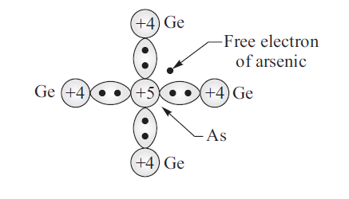
Semiconductors
n-type semiconductor
p-type semiconductor
Arsenic (Valence 5)
Germanium (Valence 4)
Aluminium (Valence 3)
Germanium (Valence 4)

Slide 95
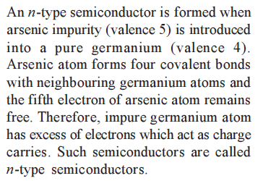
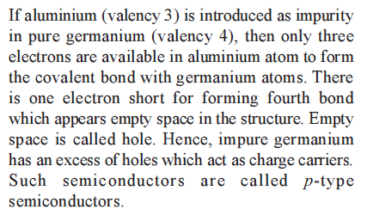
Semiconductors

Slide 96
Depletion Layer

Slide 97
Depletion Layer
An n-type semiconductor has free electrons as charge carriers while a p-type semiconductor has free holes as charge carriers. When p-n junction is formed, electrons from the n-type semiconductor and holes from the p-type semiconductor tend to diffuse to their opposite sides.
Near p-n junction, holes from p-region and electrons from n-region diffuse to opposite sides where they meet opposite carriers and get cancelled. As a result, a thin layer is formed at the junction which is free from all charge carriers. This layer is called the depletion layer.

Slide 98


Potential Barrier & Photovoltaic Effect

Slide 99



Slide 100


Slide 101


Slide 102
Thank you

